Slide 1

Unveiling Customer Behaviour: A Machine Learning Journey
Welcome! Today, we're embarking on a fascinating journey into the world of machine learning, specifically focusing on how we can predict customer reservation cancellations using the K-Nearest Neighbours (KNN) algorithm. Join me as we explore the data and uncover insights that could transform hotel management.
ML_Group2

Slide 2
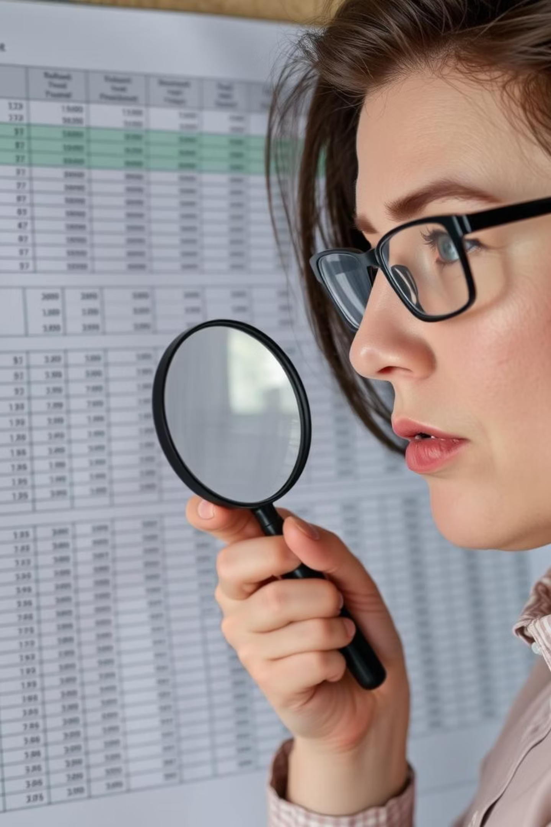
The Challenge: Predicting Cancellations
Understanding the 'Why'
Our Dataset
We're working with a rich dataset of hotel customer reservations, offering many clues about their behaviour.
Cancellations impact revenue and resource allocation. By predicting them, hotels can optimise their operations.
The ML Solution
Machine Learning, especially KNN, provides a powerful tool to identify patterns and make accurate predictions.

Slide 3

Exploratory Data Analysis (EDA): Our First Look
Our journey begins with Exploratory Data Analysis, or EDA. This is where we get to know our data, visualise its characteristics, and identify potential relationships. Think of it as peeking behind the curtain before the main show.
1
Initial Data Overview
Checking data types, missing values, and summary statistics to understand the landscape.
2
Visualising Key Features
Creating plots and figures to uncover hidden trends and correlations within the dataset.

Slide 4
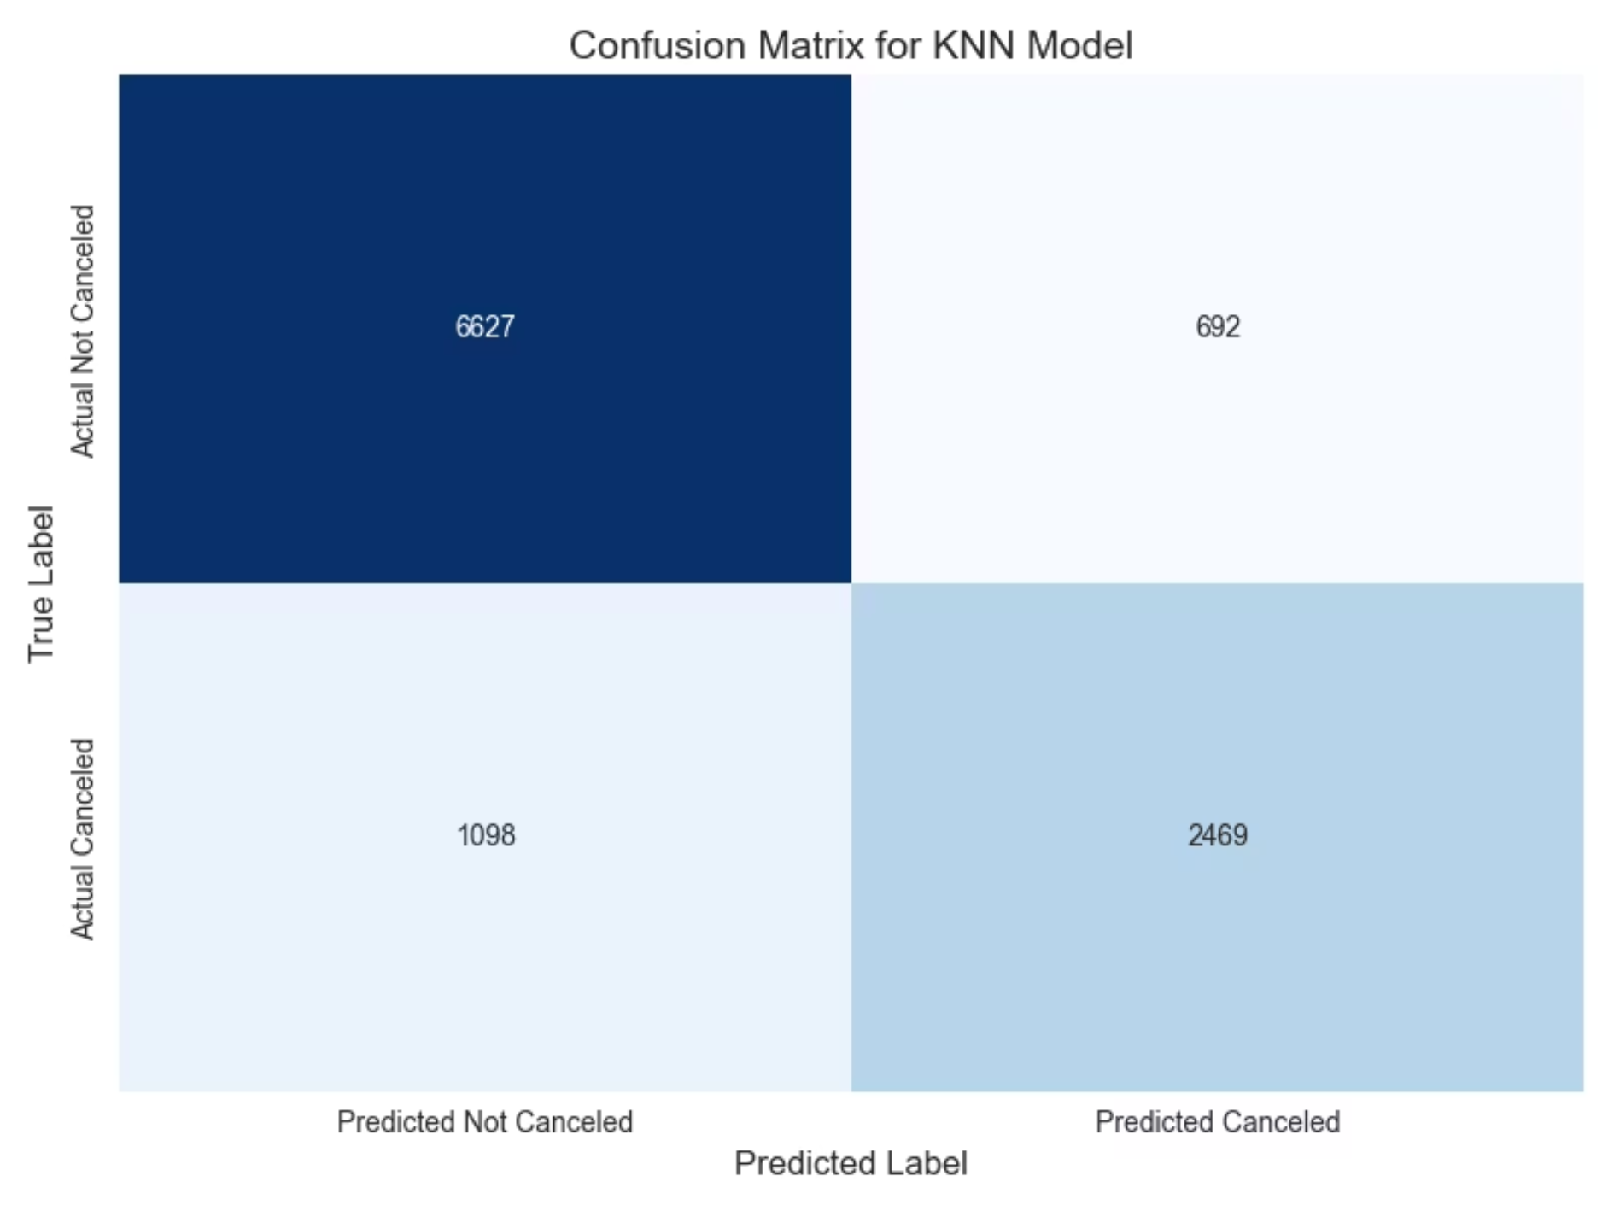
Price Sensitivity: Does Cost Drive Cancellations?
One of the most intuitive factors influencing a customer's decision is price. Let's see if our data confirms this. Do higher room rates correlate with a greater likelihood of cancellation?
ML_Group2

Slide 5
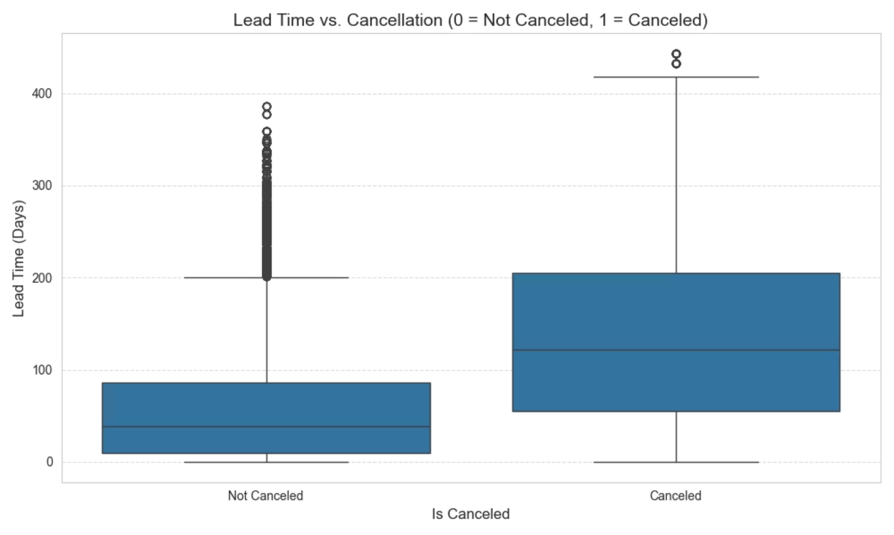
Lead Time: The Waiting Game
Lead time—the duration between booking and arrival—can also be a significant indicator. Is there a point where a very long lead time increases the chances of a change of plans?
ML_Group2
ML_Group2

Slide 6
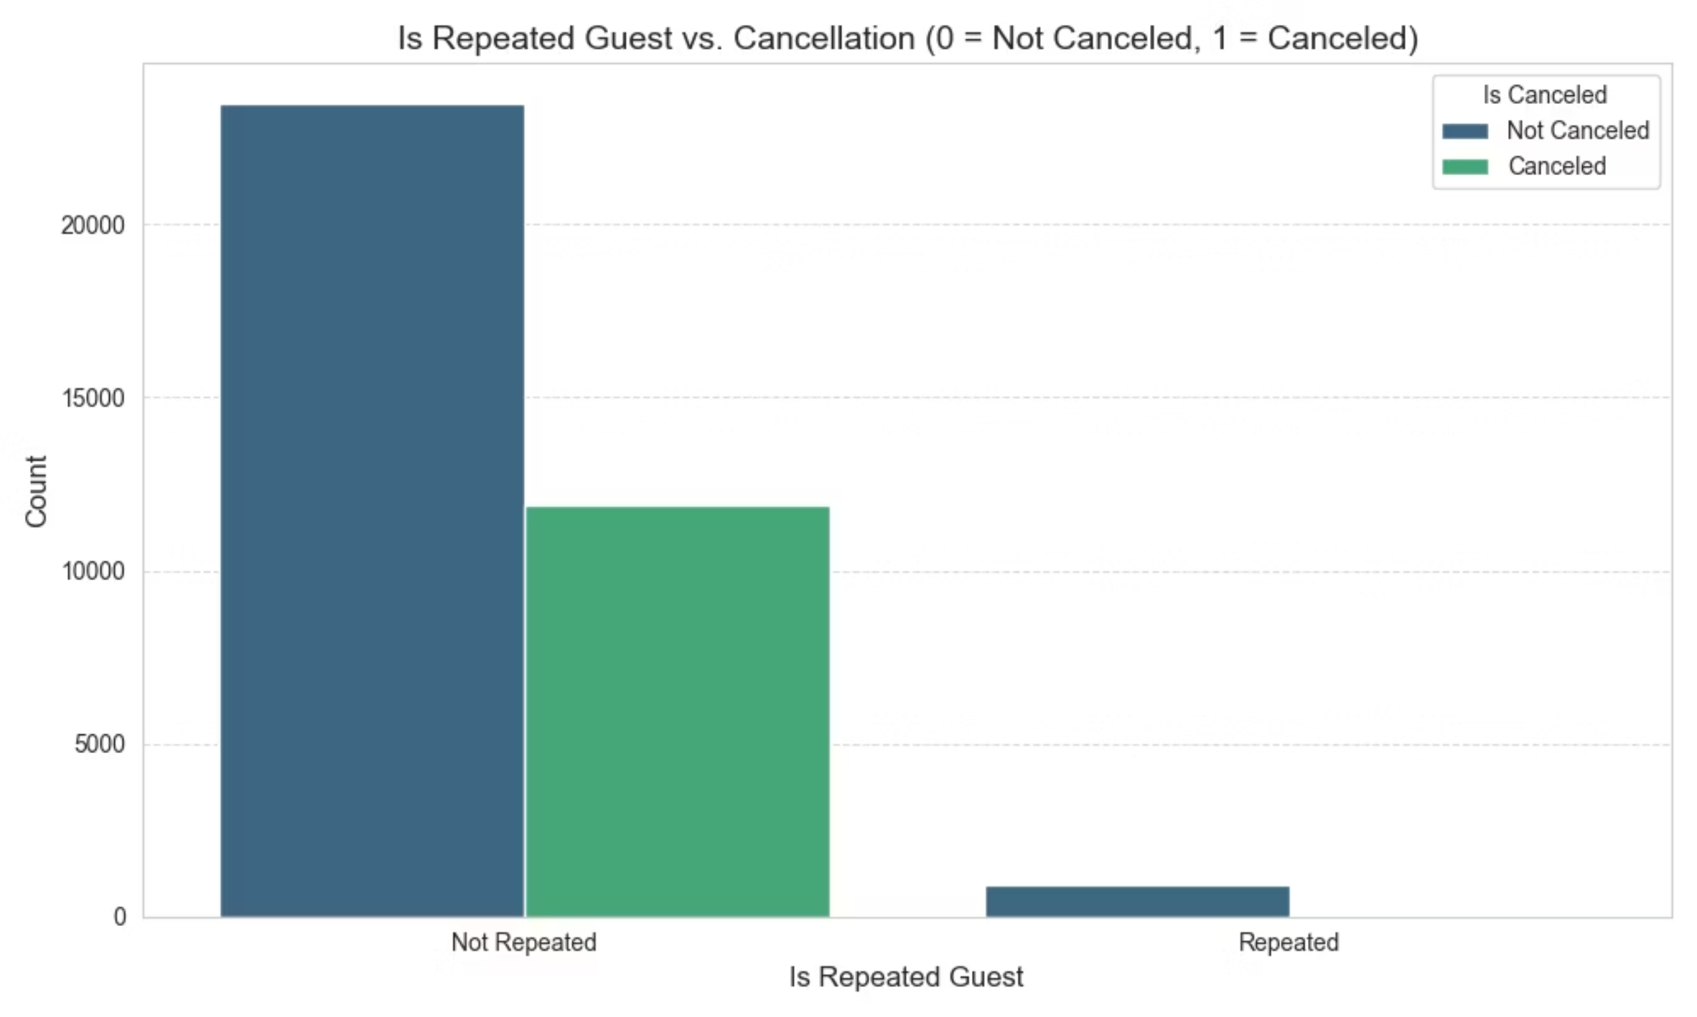
Repeat Guests: Loyalty vs. Newcomers
Are loyal customers less likely to cancel? Or does being a first-time guest contribute to a higher cancellation rate? This insight helps us tailor strategies for different customer segments.
ML_Group2

Slide 7

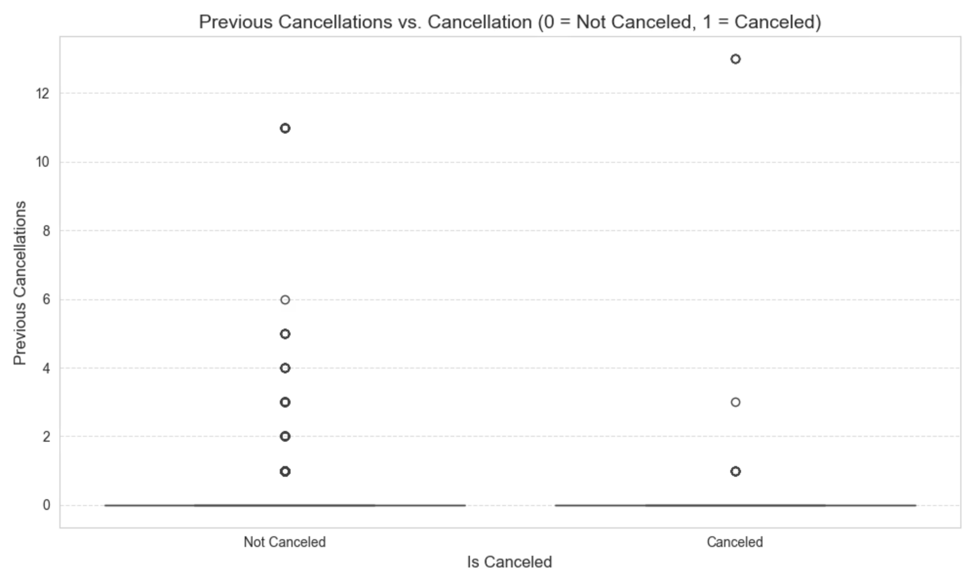



Previous Cancellations: A Predictor of Future Behaviour?
Does a history of previous cancellations and bookings (P-C) indicate a higher probability of future cancellations? This metric is crucial for understanding a customer's booking reliability.
Zero P-C Count
Customers with no previous cancellations or bookings tend to be more reliable.
Low P-C Count
A few previous cancellations might slightly increase the risk, but not significantly.
High P-C Count
A large number of previous cancellations suggests a much higher likelihood of future cancellation.
ML_Group2

Slide 8
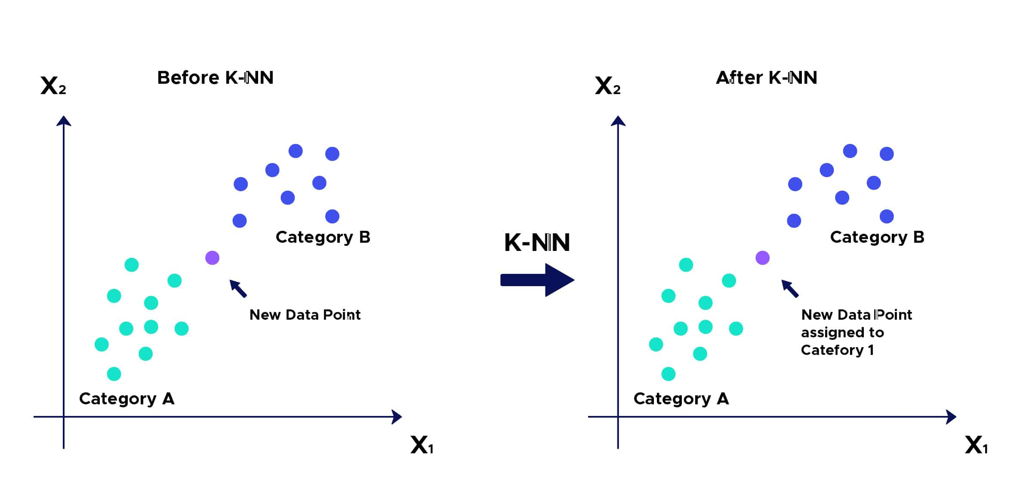
Bringing it Together: Visualising Relationships
By exploring these individual factors, we gain valuable insights. Now, imagine combining these insights! Our EDA plots help us see how these variables interact and collectively influence cancellation behaviour.
ML_Group2

Slide 9

Next Steps: The KNN Algorithm
With our EDA complete, we're ready to apply the K-Nearest Neighbours (KNN) algorithm. KNN will use these observed patterns to predict whether a new reservation is likely to be cancelled. It's like finding the 'nearest neighbours' in our data to make an informed decision.
Our next step will involve building and evaluating the KNN model, refining our predictions, and ultimately providing actionable insights for hotel management.
ML_Group2

Slide 10
Key Takeaways & Future Outlook
This internship task has been a fantastic opportunity to delve into the practical application of machine learning. Understanding the nuances of customer data empowers businesses to make smarter decisions.
1
Data-Driven Decisions
EDA is crucial for uncovering insights and setting the stage for effective machine learning.
2
Predictive Power
KNN, and ML in general, offers powerful tools to anticipate future events like cancellations.
3
Real-World Impact
These insights can lead to improved operational efficiency and enhanced customer satisfaction for hotels.
ML_Group2

